Slide 1
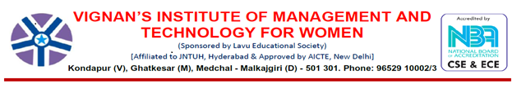
DEPARTMENT OF COMPUTER SCIENCE AND ENGINEERING
TITLE: AIR CANVAS USING PYTHON
Under the guidence of
Mrs.G.Ramya
Department of computer science and engineering
Submitted by:
SHRAVANI KOPPULA

Slide 2
CONTENTS
Abstract
Introduction
System Requirements
Literature Review
Existing Limitations
Proposed System
Proposed Methodology
Implementation
Result and Discussion
Conclusion
Future Scope
References

Slide 3

ABSTRACT
Writing is an integrated form of communication that can convey our thoughts.
A computing process that attempts to recognize and interpret human gestures through the use of mathematical algorithms is known as gesture recognition.

Slide 4
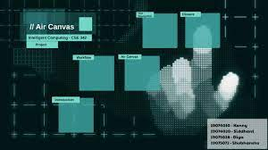
INTRODUCTION
Writing has evolved majorly over the years. Writing was first invented in 2000 BC by Neolithic people.
With the help of QWERTY keyboards we are moving towards a more digitalized form of writing. These electronic devices are slowly taking the place of traditional forms of writing with pen and paper.

Slide 5
SYSTEM REQUIREMENTS
Hardware Requirements:
System: Pentium i3Processor
Hard Disk: 500 GB
Input Devices: Keyboard, Mouse
RAM: 4GB
Software Requirements:
Operation System: Windows
Coding Language: Python
Editor: VS Code
Module: Tkinter

Slide 6
LITERATURE REVIEW
Real-time hand gesture recognition employs a variety of techniques. A system created by Shomi Khan, M. Elieas Ali[3], and Sree Sourav Das employs as skin colour identification algorithm to translate American Sign Language (ASL) from real-time video into text.
It could be difficult to identify the hand because skin tone and hand form vary from person to person.

Slide 7
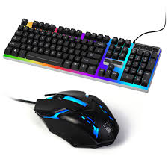
EXISTING LIMITATIONS
Existing system only works with your fingers and no highlighters and paints.
Keyboard has number of buttons that contains numbers, alphabets, symbols, and other functions keys whereas mouse has two buttons and it used for moving your cursor.
Touchscreen works as replacement to the keyboard and mouse.

Slide 8
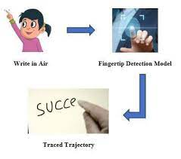
PROPOSED SYSTEM
In this proposed framework, we are going to utilize camera and the screen for the reading inputs and displaying outputs.

Slide 9
ARCHITECTURE
START
Importing necessary libraries
Creating a window frame with
various tools for drawing
Capturing the video through
webcam and detecting palm
Capturing Trajectory of finger
Displaying output
END

Slide 10
PROPOSED METHODOLOGY
Acquisition of video stream from WEBCAM
Extracting frames
Detect Hand and Hand tips using Media pipe and OpenCV
Draw the Land Hand marks
5. Detect which finger is UP:
A. If index finger is up, then user can perform any action that is writing or drawing.
B. If index and middle finger are up, then can select option from tool box. If all fingers are up, then it clears the screen.

Slide 11
FLOWCHART OF AIR CANVAS
Acquisition of video stream from WEBCAM
Extracting frames
Detect hand and hand tips using Media Pipe and OpenCV
Draw the land hand marks
Detect which finger is up
If index finger is up
User can perform any action on screen
If both index and middle finger is up
User can select option

Slide 12
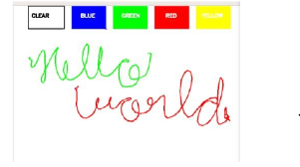
THE CAMERA USED IN AIR CANVAS
The frames that have been recorded by a laptop or PC's webcam serve as the foundation for the proposed AIR CANVAS.

Slide 13
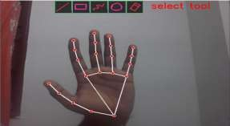
CAPTURING THE VIDEO USING WEBCAM

Slide 14
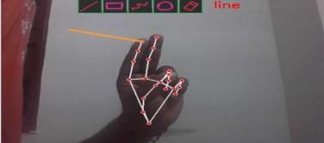
SELECTING AN OPTION

Slide 15
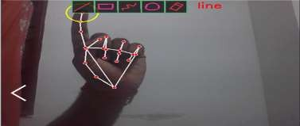
PERFORMING AN ACTION

Slide 16
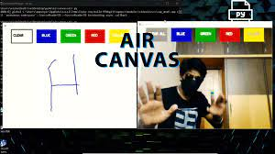
Start reading the frames and convert the captured frames to HSV color space. (Easy for color detection).
Detect the contours, find the center coordinates of largest contour and keep storing them in the array for successive frames .(Arrays for drawing points on canvas)
Requirements: python3, numpy, opencv installed on your system.
IMPLEMENTATION

Slide 17
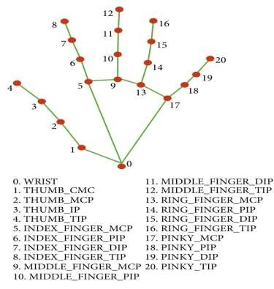
LIBRARIES USED FOR HAND TRACKING
MEDIAPIPE
HAND LANDMARK MODEL
OPENCV
NUMPY

Slide 18
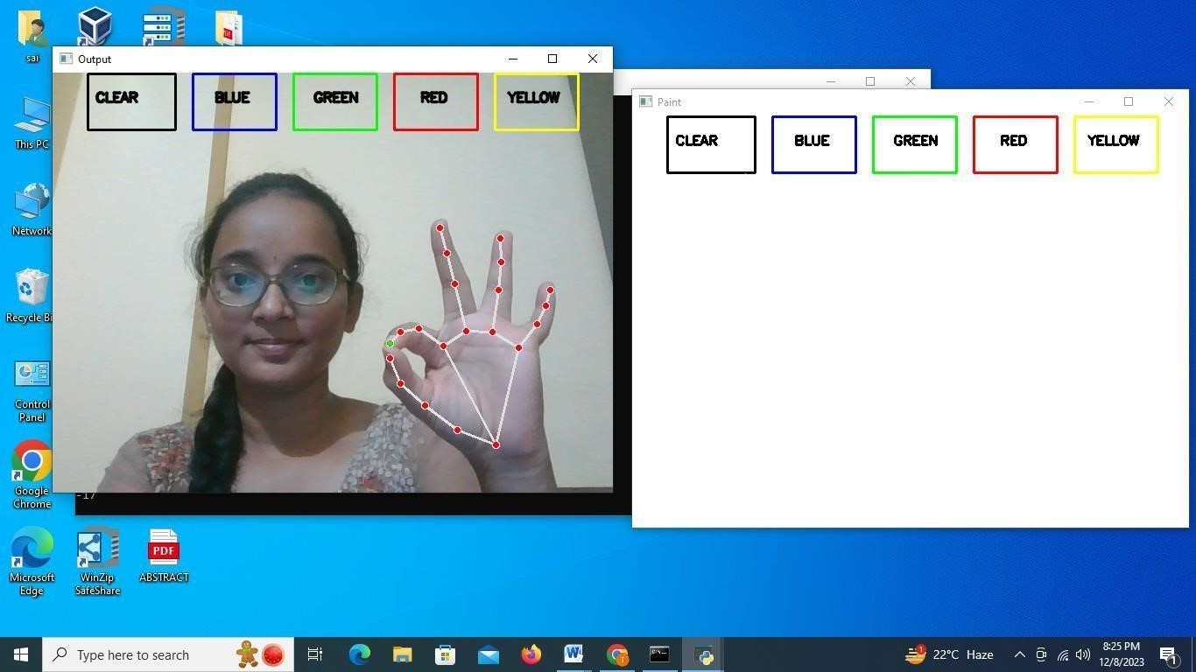
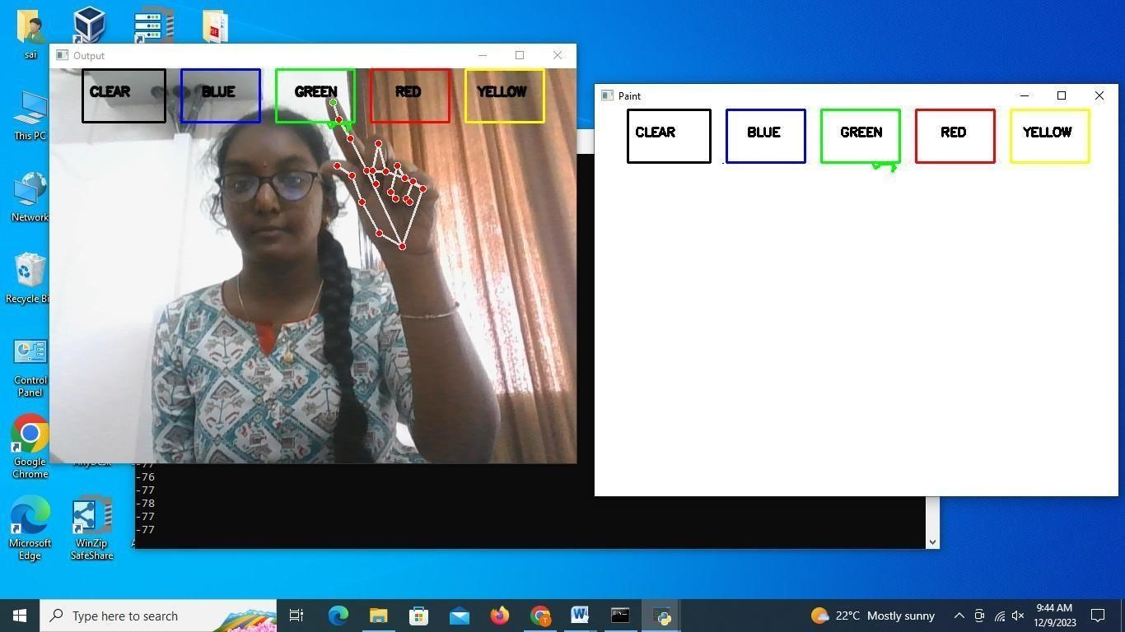
RESULT AND DISCUSSION

Slide 19
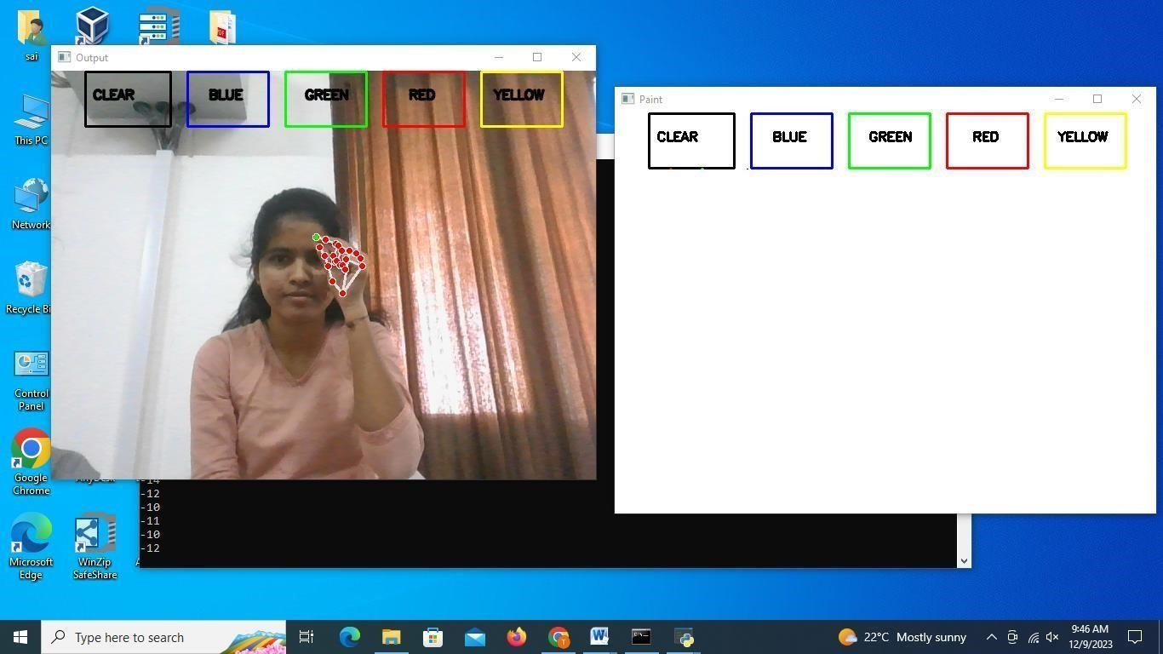
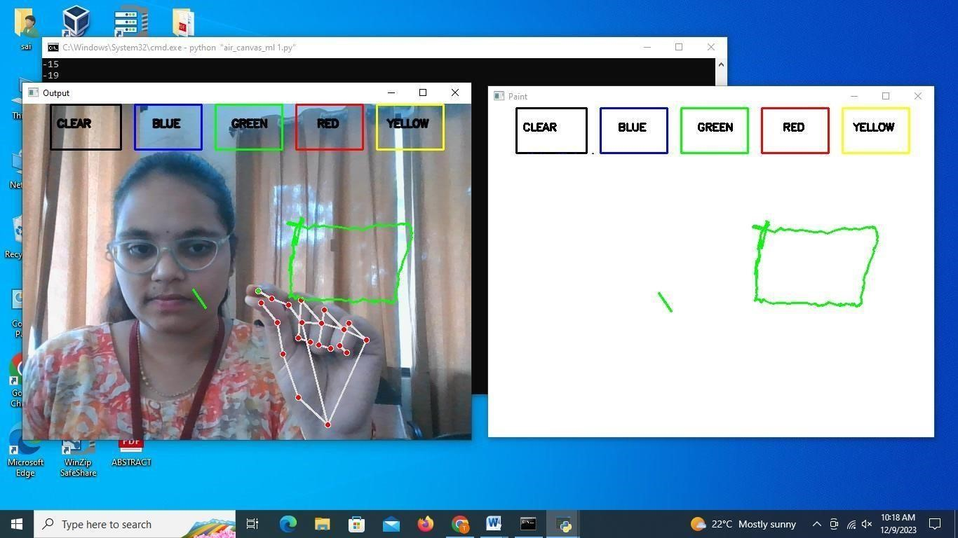

Slide 20
PERFORMANCE METRICS
Tracking Accuracy
Responsiveness
Drawing Accuracy
User Interaction
Resource Usage
Robustness
Scalability

Slide 21
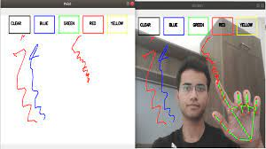
CONCLUSION
This program has the potential to challenge traditional writing methods.
Eliminates the need to carry a cell phone in hand to take notes, to give an easy way on the go to do the same.

Slide 22
FUTURE SCOPE
Air Canvas has immense future potential as a platform for artistic expression, Digital design, and Interactive experiences.
The system can be integrated with augmented reality (AR) and virtual reality (VR) technologies, enabling users to create immersive 3D artworks in a virtual space.
Expanding the system's compatibility with various devices and operating systems would broaden its accessibility and user base.

Slide 23
REFERENCES
[1] Y.Huang, X.Liu,X.Zhang, and L.Jin, "A Pointing Gesture Based Ego centric Interaction.
System: Dataset, Approach, and Application," 2016 IEEE Conference on Computer Vision and Pattern Recognition Workshops (CVPRW),LasVegas, NV,pp. 370-377,2016.
[2] P.Ramasamy, G.Prabhu, and R.Srinivasan, "An economical air writing system is converting finger movements to text using a web camera," 2016 International Conference on Recent Trends in Information Technology (ICRTIT), Chennai, pp. 1-6,2016.

Slide 24
Thank you

